Slide 1



Comprehensive loss, self-service net inventory dollar adjustment
At 06159
Let’s get back to BASICs and reduce shrink which will impact service and sales.
By SALMAN SHEZAD

Slide 2


S.M.A.R.T GOAL
At the beginning of Leap, my store was trending at a 4 weeks average of about $ - 7,600 per week on Comprehensive Loss/ Self-Service Net Inventory Dollar Adjustment.
My goal is to decrease shrink by $ - 2,600 from
$ - 7,600 to $ -5,000 in shrink per week
by November 11th , 2020.

Slide 3
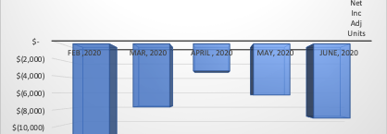
Before the start of my project

Slide 4
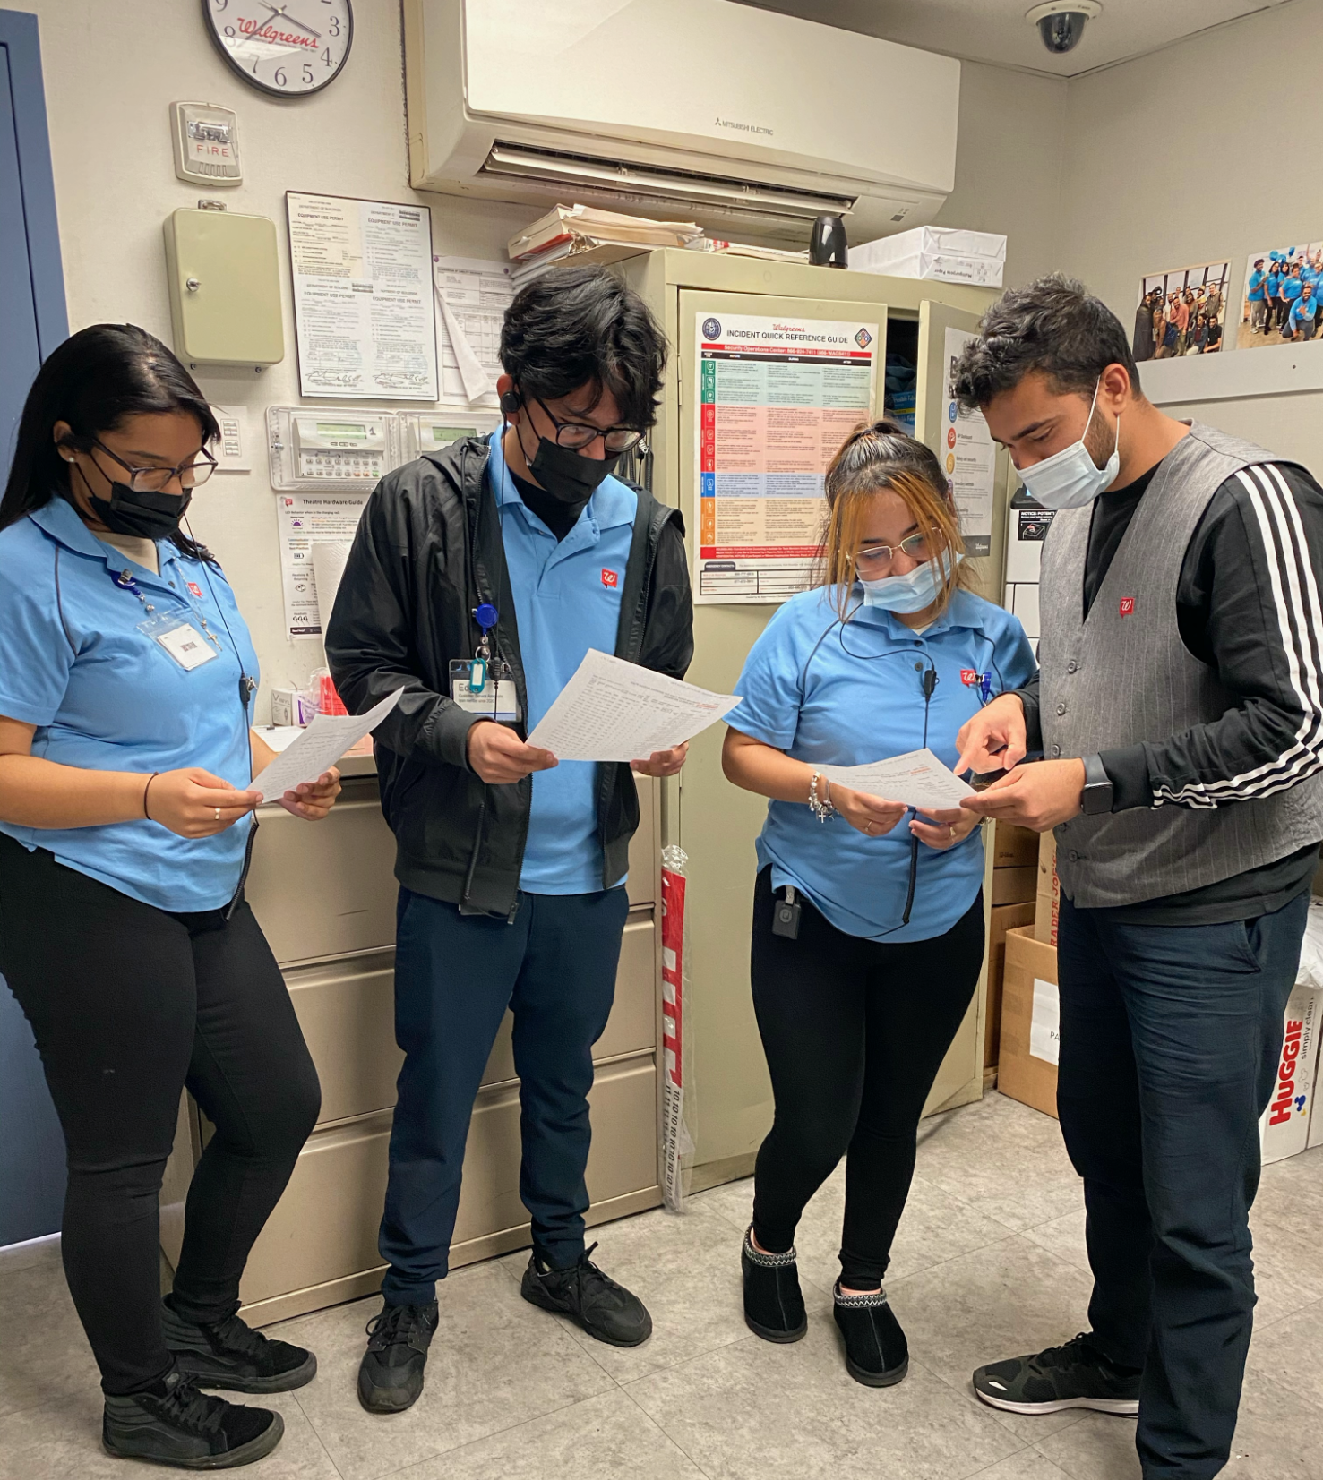
Barriers
Employees need to be more engaged to provide ECC to customers, this will reduce shrink and increase sales
Ensuring the team members complete tasks (OOR, SAGP, PERIODIC COUNTS)
Keeping Stockrooms and red carts clean, neat and organized. (CNO)

Slide 5
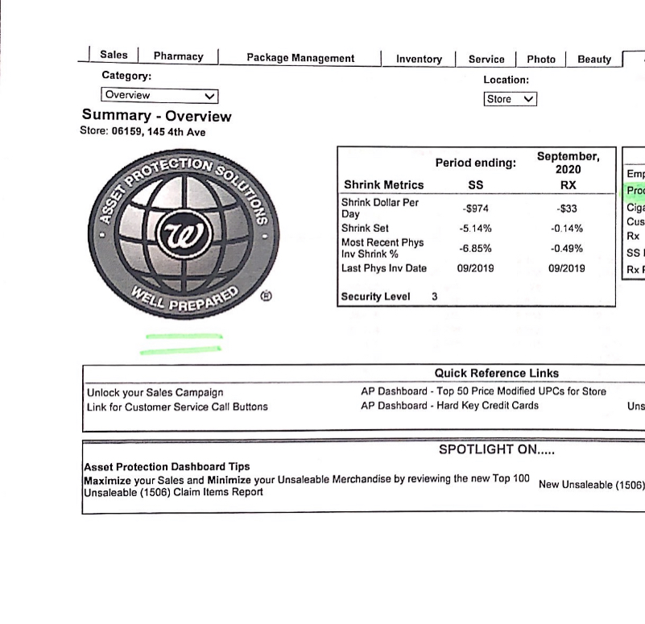
Metrics
KPI : Asset Protection Dashboard
One Plan Score card
SAGP
1506
Periodic counts

Slide 6
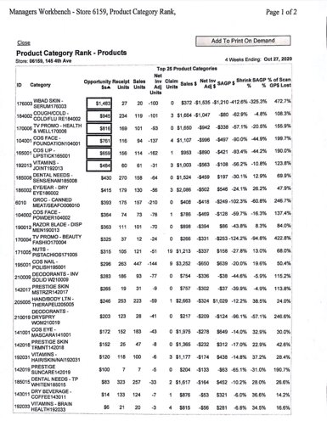
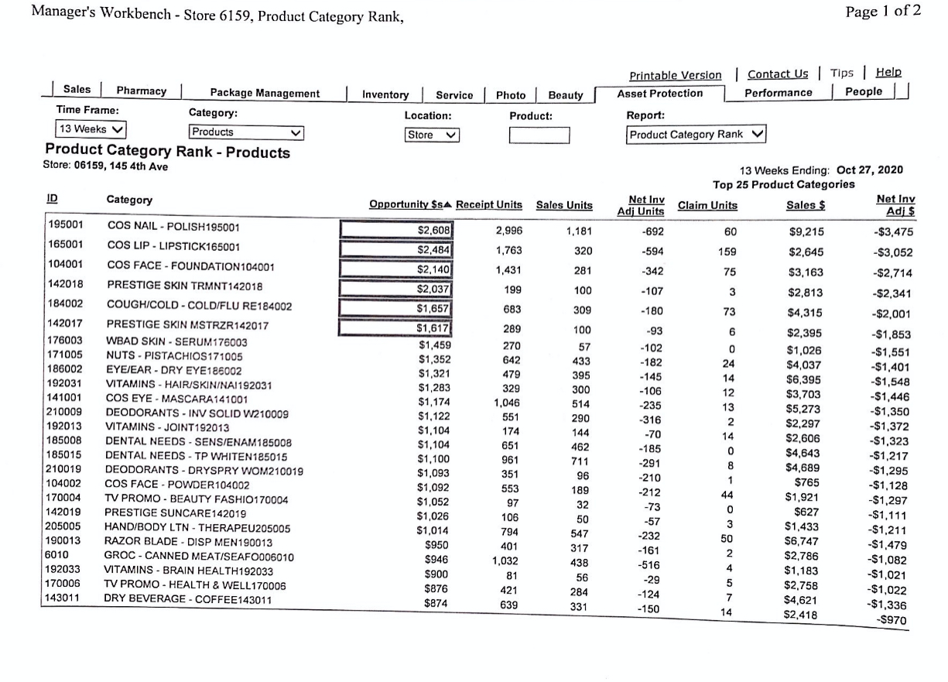
Shrink Adjustment Gross Profit (SAGP) Report

Slide 7
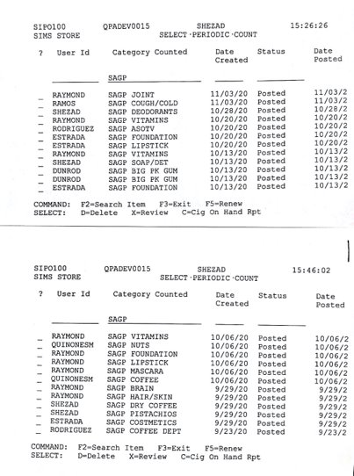
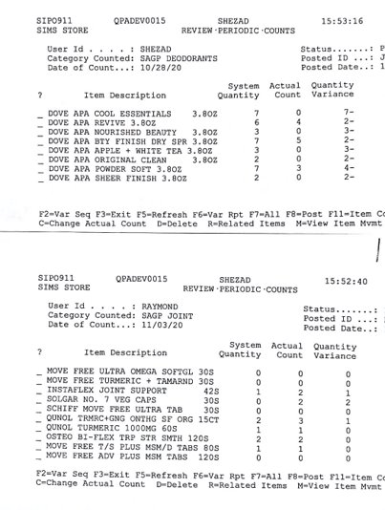
SAGP REPORTS

Slide 8
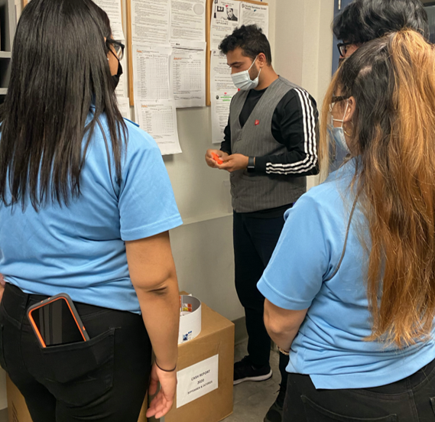
5min meeting
Sharing best practices for improving ECC.
Ensuring counts are done correctly by bay owners .
Ensuring all primary and secondary Bay owners can execute scan outs.
Conduct Smart counts 100% on daily basis.
Reduce 1506 by FIFO Rule and expired products.

Slide 9
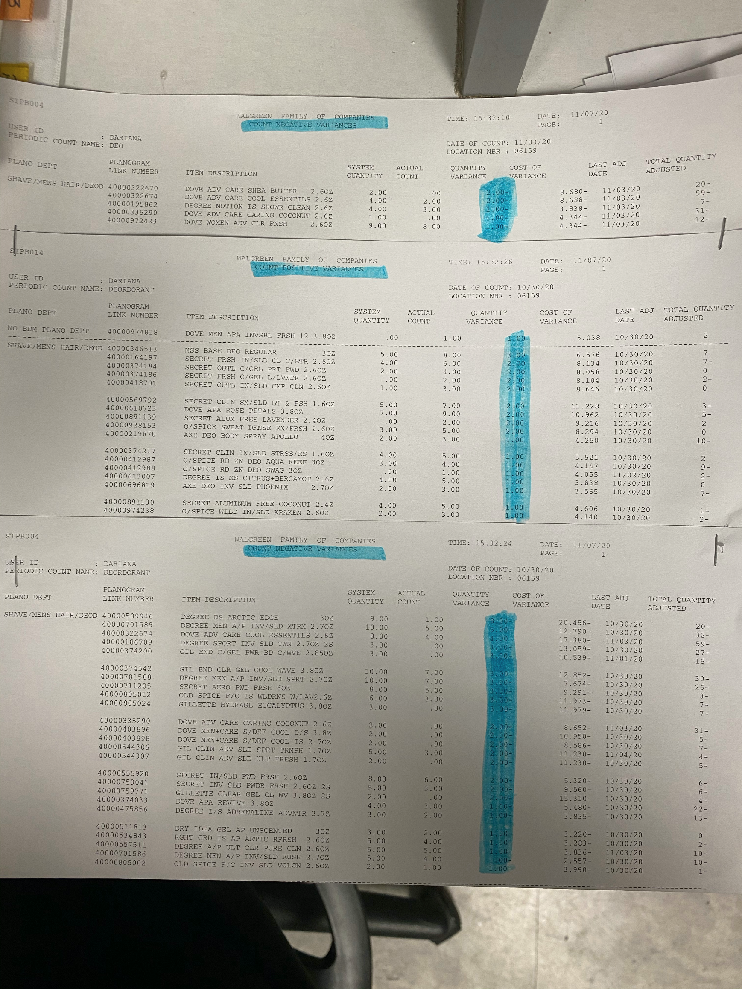
Accountability
Trained bay owners on how to conduct Item list reports, and SAGP reports
Following up with Team members after given tasks
Step 1: Using the Item List function in the Zebra, scan all the visible outs in a department. Note: Scan Quantity will be “1” for every product scanned.
Step 2: The total of the “System On Hand” that show “0” will be your numerator. The grand total of the “Scan QTY” will be your denominator.
Step 3: Divide the numerator by the denominator and multiply that number by 100. That percentage is your department’s outs accuracy!
Step 4: Now, you will need to pull your department, check duplicate locations and adjust your On Hands accordingly.

Slide 10
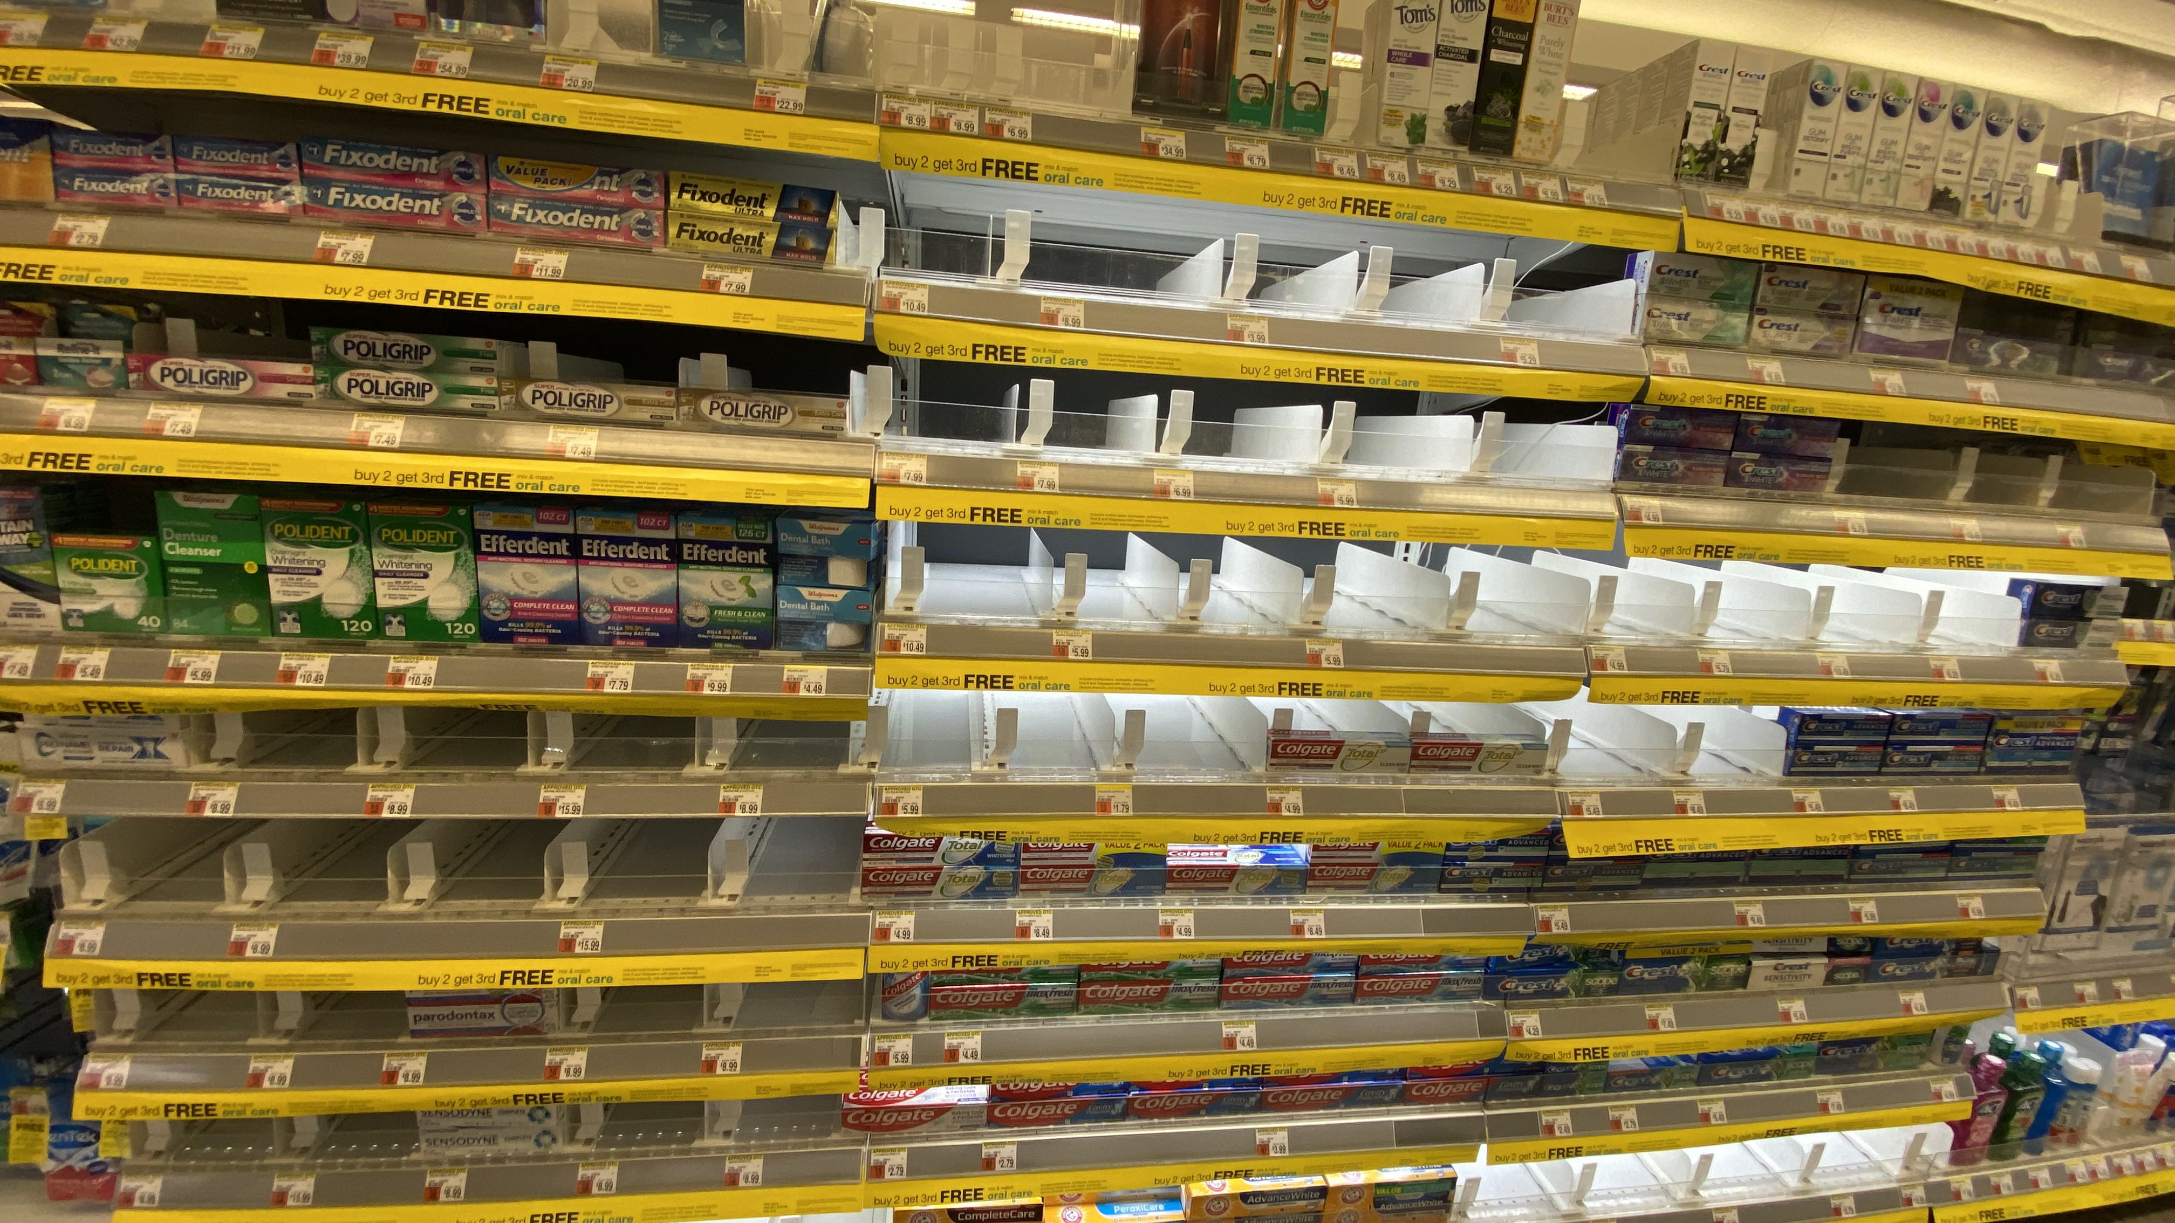
BEFORE

Slide 11
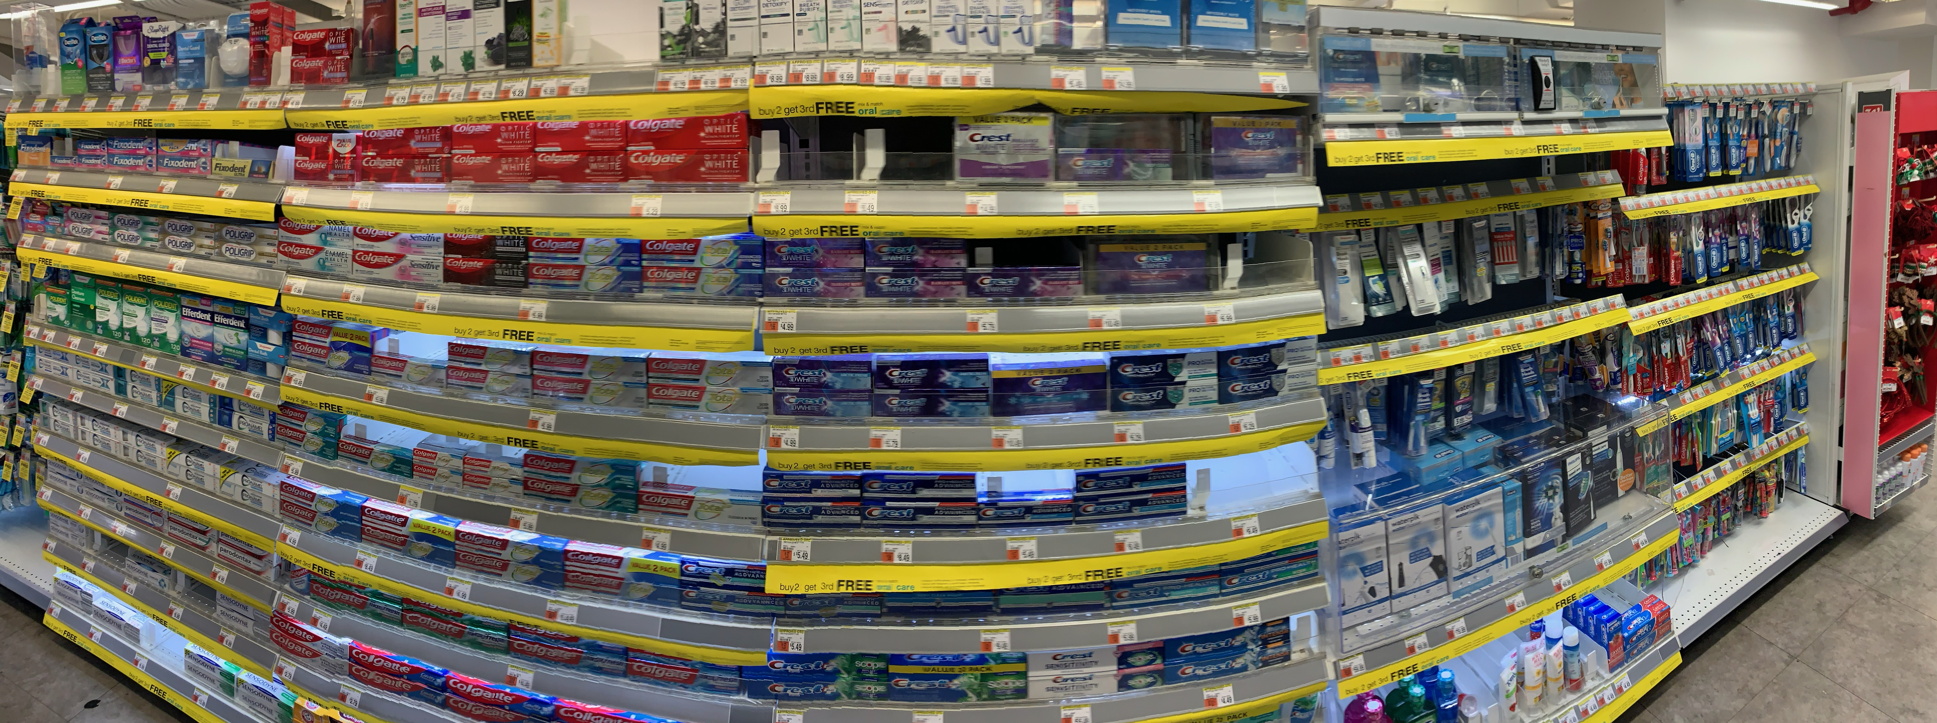
Overall Results
AFTER
As a result of my project I gained a lot of ideas and insights about shrink in my store. I was able to coach and develop my team with the help of my fellow peers and leaders, but there is a lot more that needs to be done, like continuing to train team members to be more engaged to provide ECC to every customer that can help reduce shrink and in turn increase sales.

Slide 12
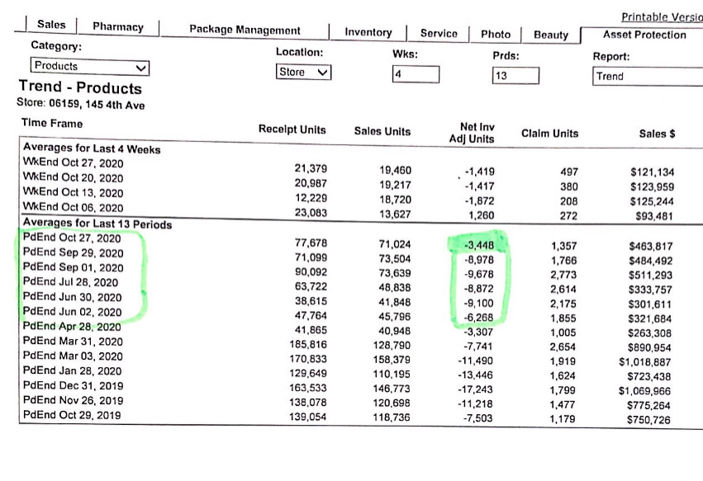
Trend Report

Slide 13
SS Adjustment Results
The Project Goal - My goal is to reduce that from $ – 7,600 to
$ -5,000
The Project Results - I was able to reach my goal to $ - 3,400 as of Oct 27, 2020

Slide 14
Resources
Partner up with my peers to make sure team members are properly trained to complete given tasks.
Store walks with District Manager and Asset Protection Manager on ideas and insights on how we can reduce shrink and increase sales.
Following up with reports from the AP Dashboard and periodic counts.
The LEAP facilitators.
My Store Manager and ASM.

Slide 15
Project Benefits
What I learned:
What I was able to teach:
Proper planning prevents poor performance – strategic planning and time management are key;
Training, providing feedback, and coaching make for an engaged, accountable team;
Praise goes a long way;
Employees like to help each other and feel like they are valued at both personal and professional level;
Have learned how to effectively read the metrics and translate them into behaviors that impact them.
How to properly perform all steps in SAGP;
The what and whys behind company initiatives like concentrating on comprehensive loss;
How to locate high shrink items, and limit them on shelf;
Sections detailing, and higher expectations in regards with department limitations;
The importance of teamwork, inspiring and winning together.

Slide 16
Project accomplishments
In stock and departments appearance improved;
Stockroom condition is perfect – organized red carts for better understanding of products when counting;
Great improvement in employee engagement and motivation;
Greater sense of pride;
Stronger team relations, employees helping each other by sharing experiences;
Leadership empowers team members to make decisions and to be accountable for their departments;
Employees as well as leadership are showing better time management.

Slide 17

Thank you
Now lets' get back to BASICs

